Slide 1
How the Tobacco Companies will use the
Trans-Pacific Partnership Agreement to Block Sensible Public Health Policies
Stanton A. Glantz, PhD
Eric Crosbie, MA
University of California, San Francisco
13th Round of TPP Negotiations
July 2, 2012

Slide 2
Tobacco Companies
Sell 6 trillion cigarettes annually
Kill 5.4 million annually
By 2030 will kill 8 million annually
1 billion deaths expected for 21st century
80% of smokers now live in developing world

Slide 3
Tobacco Control Policies Work
Smokefree policies
Marketing bans
Increased taxes
Warning labels
Prevent smoking and encourage cessation
Improve health
  Rapid impacts on heart disease
Cost multinational tobacco companies billions

Slide 4
Tobacco Companies
Bigger Than Most Countries
British American Tobacco
  $50 billion annual sales
Philip Morris International
  $66 billion annual sales
  Larger than 139 countries’ GDP
Notes:
U.S.-$15 trillion
Japan-$4 trillion
Australia-$917 billion
Malaysia-$447 billion
Singapore-$314 billion
Peru-$301 billion
Vietnam-$299 billion
Chile-$281 billion
New Zealand-$123 billion
Brunei-$21 billion

Slide 5
Preemption
Eliminate authority of governments to implement sensible public health policies to protect their people
Local clean indoor air
Companies routinely sue claiming preemption
  Even when not there
  Raise cost of protecting the public
  Deter action
Bully governments

Slide 6
The tobacco companies will argue that the TPP preempts all tobacco regulation

Slide 7
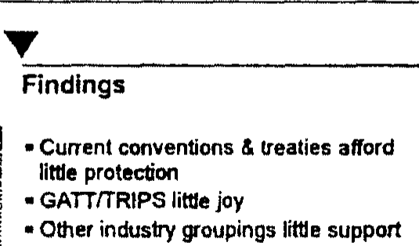
Tobacco companies threaten governments even when their lawyers tell them they don’t have a case
Tobacco Company Plain Pack Group July 1994
tid/mjk78a99
Notes:
However a Plain Pack Group Slide Presentation in July 1994 showed that the tobacco companies initial international approach had failed as the international treaties offered little protection and other industries offered little support.

Slide 8
Success in Bullying Governments
In 1994 threatened governments with multi-billion lawsuits for damages
Governments withdrew proposals for plain packaging out of fear of losing in court
  Australia (Paris Convention, WTO, TRIPS)
  Canada (Paris Convention, WTO, TRIPS, NAFTA)
Delayed these innovations for decades

Slide 9
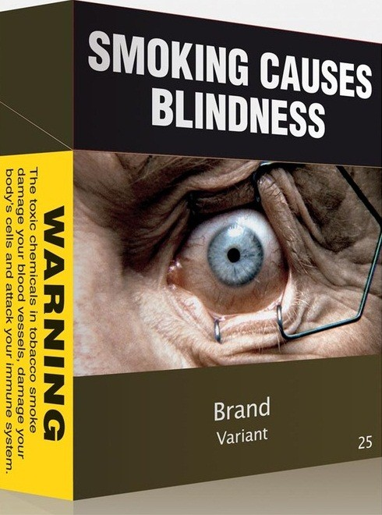
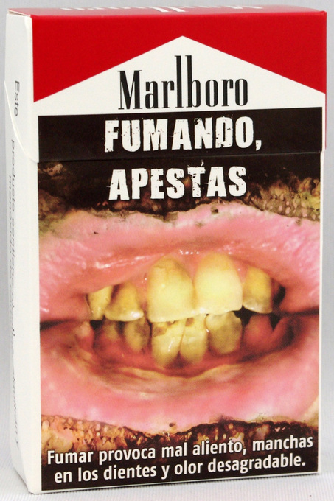
Current Attacks on Public Health
Domestic Tobacco Control Policies
  Uruguay-Graphic Health Warning Labels covering 80% (2008)
  Australia-Plain Packaging (2012)
  Other governments seeking plain packaging (ex. New Zealand)
PMI Bilateral Investment Treaty Challenges
  Uruguay-Switzerland BIT
  Australia-Hong Kong BIT

Slide 10
PMI involvement during
TPP negotiations
PMI lobbying USTR
  2010-Submitted comments for ISDS mechanism
    PMI searching for new avenues to block public health policies
PMI lobbying TPP member countries
  2012-Sponsored a closed meeting with trade representatives from TPP member countries
    Violates WHO FCTC Article 5.3

Slide 11
TPP Investor Rights
Investor-state dispute settlement (ISDS) mechanism
Allows foreign companies to “directly” sue governments
Will unleash tobacco companies

Slide 12
Solution for Tobacco in TPPA
Ambiguous language creates opportunities for the tobacco companies’ lawyers to exploit
Simplest and best solution is complete carve out tobacco

