Slide 1
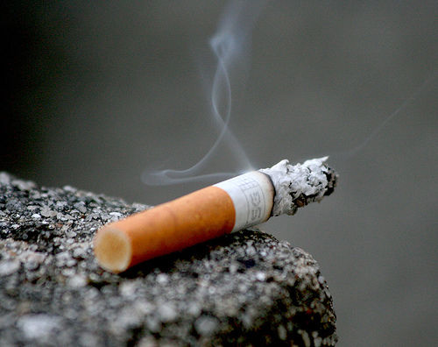



Tobacco Control and Trade
International Legal Arguments in Support of a Tobacco Exemption in the TPP
Timothy K. Mackey, MAS
USTR TPP Negotiations
San Diego, CA 2012

Slide 2
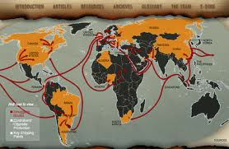

Tobacco and Trade
Global epidemic killing 6 million annually, projected 600,000 non-smokers die from second hand exposure, #1 preventable cause of death
Liberalizing trade practices may lead to increased marketing, stimulating demand for tobacco
States must enact evidence-based policy-making to counteract these negative public health impacts

Slide 3


Framework Convention on Tobacco Control
WHO Framework Convention on Tobacco Control (FCTC) is the sole public health treaty
176 member states are parties to FCTC
Landmark binding international treaty specifically agreed upon for the fight against the global health tobacco epidemic
Signatory states are obligated to implement requirements of FCTC

Slide 4
Framework Convention on Tobacco Control
Obligations under FCTC
Limitations on lobbying from industry
Tax measures for demand reduction and addiction/cessation programs
Limit passive smoking (i.e. 2nd hand smoke)
Regulation of contents and emissions
Advertising ban and raising awareness/additional research
Restrict sales to minors and eliminate smuggling
Health warnings/labelling on tobacco products

Slide 5
FCTC Implementation of Tobacco Control Measures
Select State Tobacco Control Measures
Uruguay: Requires health warnings that cover 80% of principal display areas, use of images, and single presentation requirement
Australia: Recently adopted “plain packaging” national tobacco legislation to be implemented by Dec 2012
United States: Domestic legislation under Family Smoking Prevention and Tobacco Control Act prohibiting cigarettes containing constituent characterizing flavor other than menthol or tobacco
United States: Domestic legislation under FSPTCA implementing FCTC federally mandated graphic cigarette warning labels by FDA (currently challenged as unconstitutional by industry in US courts)

Slide 6
Challenges to FCTC Tobacco Control Measures
Regional and Bilateral FTAs
Phillip Morris (Norway) makes challenge against Norwegian bans on point-of-sale display bans under European Economic Area Agreement
Phillip Morris (Switzerland) brings claim against Uruguay packaging measure under bilateral investment treaty
Phillip Morris (Hong Kong) brings claim against Australia plain-packaging under bilateral investment treaty and other treaties
Member State Challenges
Indonesia: Challenges and wins in claim against USA clover flavour prohibition under WTO TBT

Slide 7
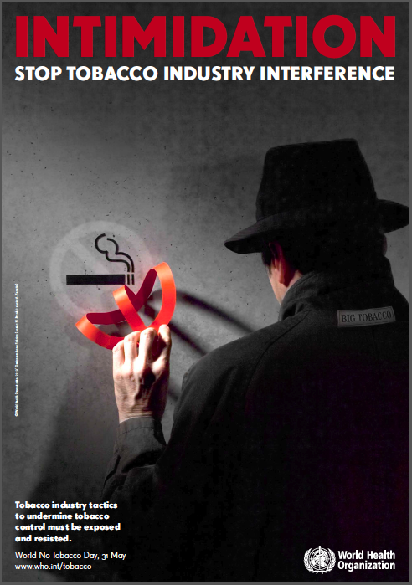
Consequences of Trade-related Challenges
Member states cannot meet obligations of FCTC for implementation of tobacco control legislation
Industry suits, and associated investor-state rights, allow for multimillion dollar claims for compensation limiting state tobacco control interventions
Failure to specifically provide exclusion for tobacco could create presumptive argument against future tobacco-trade disputes

Slide 8
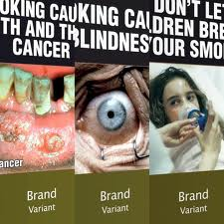
Case Studies: Australia Plain Packaging Legislation
Prohibits use of manufacturer logos, brands, and colors (trademarks and trade dress)
Requires all packaging to be of the same color and design
Requires brand name of tobacco to be displayed in standardized, non-stylized format

Slide 9




Case Studies: Australia Plain Packaging Legislation
Challenges to Legislation
Tobacco producing countries have claimed it violates TRIPS, Paris convention, GATS or FTA provisions regarding use of trademarks
Legal challenges from tobacco industry on IP grounds, economic considerations, and claims that it will impede efforts against smuggling
Claim that plain packaging is not supported by scientific evidence for efficacy
Notes:
After the legislation passed, tobacco giant Philip Morris announced it had started legal action against the Government.
The company says it has served a notice of arbitration under Australia's Bilateral Investment Treaty with Hong Kong.
Since the legislation's announcement, the plan has faced fierce opposition from tobacco companies who have vowed to challenge the Government's ability to remove trademarks from packages.
Philip Morris spokeswoman Anne Edwards says the company has been left with "no option" but to pursue legal action.
"The Government has passed this legislation despite being unable to demonstrate that it will be effective at reducing smoking and has ignored the widespread concerns raised in Australia and internationally regarding the serious legal issues associated with plain packaging," she said.
Philip Morris says it will seek a suspension on the plain packaging laws as well as compensation for the loss of trademarks.

Slide 10
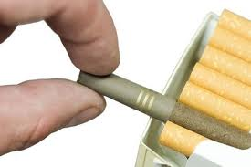

Case Studies: United States – Clove Cigarettes
Indonesia challenges US restrictions on flavoured tobacco products prohibiting clove cigarettes
Found to be discriminatory in violation of Article 2.1 of WTO Agreement on Technical Barriers to Trade
However, adjudication panel makes extensive use of FCTC guidelines for implementation in analysis

Slide 11
Policy Coherence?
International Agreements Prioritizing Public Health
Doha Declaration on the WTO TRIPS Agreement reaffirming rights and flexibilities of member states to adopt laws, regulations, and measures to protect public health [WTO members]
Punta del Este Declaration reinforces states rights under FCTC to implement tobacco control measures and seeks policy coherence in trade and health policies [FCTC parties]
Domestic Policy
Doggett Amendment and EO 13913 forbids US government agencies from promoting sale or export of tobacco or seeking to reduce or remove nondiscriminatory restrictions on marketing of tobacco [US agencies]
Notes:
Both reaffirm the priority given to FCTC in interpreting trade-related disputes on tobacco control
Doggett amendment reaffirms responsibility of US agencies (including USTR) not to promote or remove tobacco restrictions

Slide 12

Framework Convention on Tobacco Control
Specific Clauses Relating to Trade
Article 5.3: Provides that when implementing FCTC parties should not grant tobacco industry incentives for investment and should restrict dealings
Article 2.2: Governs that future bilateral and multilateral agreements must be compatible with FCTC giving it priority in the event of a conflict

Slide 13
Steps States Can Take Against Trade Claims
Ensure specific commitments are not made to foreign investors in tobacco industry
Clarify key provisions of future international trade and investment agreements
This can be accomplished by advocating for total exclusion of tobacco from all provisions of TPP (specifically IP and investor-state); OR
Specifically reference FCTC as controlling standards for tobacco related disputes in TPP
International Treaty Law
Treaties are not interpreted in isolation
Article 30 of Vienna Convention generally states that the treaty concluded at later time is given priority (TPP would not be covered)
FCTC should and can be used in context of interpreting int’l trade and investment agreements

Slide 14


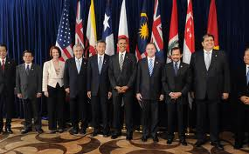
Simplifying…
Tobacco exclusion in accordance with FCTC Art. 2.2
Vienna Convention: Article 30
Controlling Rationale
Establishes precedence of FCTC as sole international binding agreement on tobacco-related adjudication
Policy coherence reaffirming existing principles of state rights to utilize public health interventions for tobacco
Ensure continued progress in global health efforts against the deleterious social and economic impacts of tobacco
WTO Agreements
TPP

Slide 15








Support for Exclusion on Tobacco in TPP and all FTAs
Several leading public health groups, medical practice societies, and other civil society actors support tobacco exclusion for TPP…
CPATH.ORG

Slide 16
Thank You
Contact Info
Timothy Ken Mackey, MAS
Email: tmackey@ucsd.edu
Affiliations: Joint Doctoral Program in Global Health, UCSD-SDSU & Institute of Health Law Studies, California Western School of Law

